Slide 1

Digital Marketing project phase 2☺:-
Team Leader : -
YERRA KAVYA Team members:-
SEEDARAPU SREEJA VUYAKA JAYALAXMI
UNKILI JAYASRI VAJJA KAVYANJALI

Slide 2
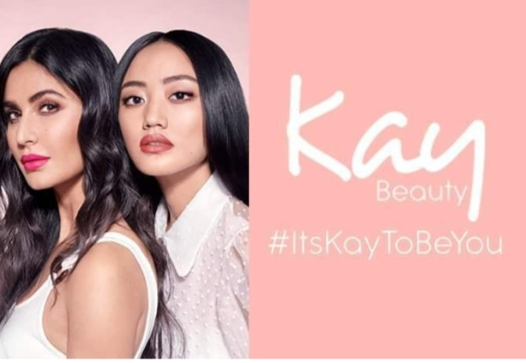

KAY BEAUTY☺ :-

Slide 3
Mission/Values☺:-
Missions of Kay Beauty:-
Quality: Providing makeup products that meet high standards of quality and performance. Inclusivity: Offering products suitable for a diverse range of skin tones and types. Innovation: Introducing innovative formulations and trends in the beauty industry. Empowerment: Encouraging self-expression and confidence through makeup.
Sustainability: Incorporating eco-friendly practices and materials into their products and packaging. Accessibility: Ensuring that their products are accessible to a wide range of consumers in terms of affordability and availability.

Slide 4
Values of kay Beauty☺:-
Empowerment: Encouraging self-expression and confidence through makeup, empowering individuals to embrace their unique beauty. Inclusivity: Celebrating diversity and ensuring that their products are suitable for people of all skin tones, types, and backgrounds. Quality: Commitment to providing high-quality makeup products that meet the expectations of their customers.
Innovation: Embracing innovation in product development and staying ahead of trends in the beauty industry. Sustainability: Integrating sustainable practices into their business operations, including eco-friendly packaging and ingredients. Community: Building a supportive community of makeup enthusiasts and fostering positive relationships with customers.

Slide 5
Brand study of kay Beauty☺:-
A brand study of Kay Beauty would typically involve analyzing various aspects such as its target audience, brand positioning, marketing strategies, product offerings, brand identity, and competitive landscape. Kay Beauty, founded by actress Katrina Kaif, is known for its cruelty-free and vegan makeup products designed to cater to the modern Indian woman. The study would likely delve into how the brand has positioned itself within the beauty industry, its unique selling points, its use of influencer marketing, and its overall success in capturing market share.
Additionally, it would examine customer perceptions and reviews to gauge the brand’s reputation and effectiveness in meeting consumer needs. It would analyze how the brand leverages Katrina Kofi's celebrity status, its focus on cruelty-free and vegan products, its pricing strategy, distribution channels, and online presence to differentiate itself and appeal to its target market. The study would also assess customer perceptions, satisfaction levels, and brand loyalty to evaluate Kay Beauty’s overall performance and potential for growth in the beauty market.

Slide 6
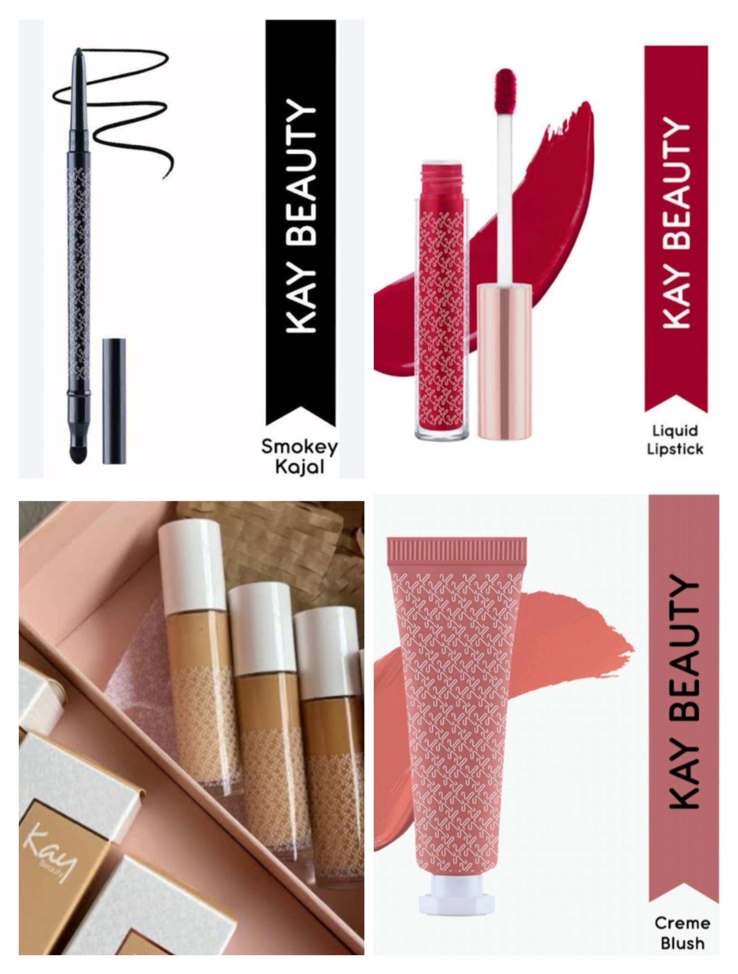

Slide 7
USP OF KAY BEAUTY☺:-
The Unique Selling Proposition (USP) of Kay Beauty, founded by actress Katrina Kaif, lies in its focus on quality, innovation, and inclusivity. Kay Beauty offers a range of makeup products designed to suit diverse skin tones and preferences, with an emphasis on cruelty-free formulations and vibrant, trend-setting shades.
It’s what sets something apart from the competition, what makes it special or unique. So, when you’re talking about the USP of beauty products, you might be referring to what makes them different from other products in the market. It could be anything from special ingredients to specific benefits like long-lasting effects or eco-friendliness.Kay Beauty could include its focus on cruelty-free and vegan products, innovative formulations, diverse shade ranges, or its association with a celebrity like Katrina Kaif, depending on their marketing strategy and customer appeal.

Slide 8
Analyze Brand tone and identity☺:-
Kay Beauty’s brand tone and identity are likely to reflect sophistication, empowerment, and inclusivity, mirroring its founder Katrina Kofi's persona. The tone may be confident yet approachable, appealing to a diverse audience. The brand identity might emphasize self-expression, beauty as a form of empowerment, and the celebration of individuality. It may also highlight the importance of quality, innovation, and ethical practices in the beauty industry, aligning with contemporary consumer values.
Set 5 SMART goals and KPIs for the same:-
Five SMART goals (Specific, Measurable, Achievable, Relevant, Time-bound) along with Key Performance Indicators (KPIs) for Kay Beauty:
1)Goal: Increase online sales by 30% within the next 12 months. KPIs: Monthly online sales revenue Conversion rate (percentage of website visitors who make a purchase) Average order value Number of new customers acquired through online channels.

Slide 9
Goals and KPI’S of Kay Beauty☺:-
2)Goal: Expand product distribution to 500 additional retail stores within the next 6 months.
KPIs: Number of new retail partnerships secured Percentage increase in total retail outlets carrying Kay Beauty products Sales performance in newly added retail stores Customer feedback and satisfaction from new retail locations.
3)Goal: Enhance brand awareness by increasing social media engagement by 50% over the next 9 months. KPIs: Total followers across social media platforms (Instagram, Facebook, Twitter, etc.) Average likes, comments, and shares per post Reach and impressions of social media content Growth in mentions and hashtags related to Kay Beauty.

Slide 10
4)Goal: Improve customer satisfaction ratings to 90% within the next year. KPIs: Customer satisfaction surveys (average rating) Net Promoter Score (NPS) Rate of returns and refunds Response time to customer inquiries and complaints.
5)Goal: Launch two new product lines and achieve $1 million in revenue from these lines within the next 18 months. KPIs: Sales revenue generated from the new product lines Rate of adoption of new products by existing customers Customer feedback and reviews for new products Time to market for new product launches.

Slide 11
Part 1:-Brand study, Competitor analysis & Buyer’s/Audience’s Persona☺:-
Buyer’s audience Persona:- Demographics: Detail the demographic characteristics of Kay Beauty’s target customers, such as age, gender, income, and location. Psychographics: Understand the psychographic profiles of Kay Beauty’s audience, including their lifestyles, values, interests, and aspirations. Pain Points: Identify the problems or challenges that Kay Beauty’s audience faces related to beauty and cosmetics. Goals: Determine the goals and desires of Kay Beauty’s audience when it comes to their beauty routines and self-care.
Preferences: Explore the preferences and behaviours of Kay Beauty’s audience regarding beauty products, shopping habits, and brand loyalty. Media Consumption Habits: Understand where Kay Beauty’s audience spends their time online and offline, including social media platforms, beauty forums, and traditional media channels.

Slide 12
Part 1:-Brand study, Competitor analysis & Buyer’s/Audience’s Persona☺:-
Competitor Analysis:-
Key Competitors: Identify major competitors in the cosmetics and beauty industry that directly compete with Kay Beauty. Strengths and Weaknesses: Assess the strengths and weaknesses of each competitor, including their product offerings, brand reputation, distribution channels, and marketing strategies. Market Share: Estimate the market share of each competitor compared to Kay Beauty and how it fluctuates over time.
Target Audience: Understand the target audience of each competitor and how it overlaps or differs from Kay Beauty’s target audience. Pricing Strategies: Analyze the pricing strategies employed by competitors and how they compare to Kay Beauty’s pricing. Unique Selling Points: Identify any unique selling points or competitive advantages that Kay Beauty or its competitors possess.

Slide 13
Competitors of Kay Beauty:-
Competitors of Kay Beauty in the cosmetics and beauty industry may include:
Nykaa Beauty: Nykaa offers a wide range of cosmetics and beauty products, including its own brand, which competes directly with Kay Beauty. Maybelline New York: Maybelline is a globally recognized cosmetics brand known for its diverse product range and innovative formulations, competing in similar market segments as Kay Beauty.
YeFaces Canada: Faces Canada offers a wide range of makeup and skincare products, targeting similar consumer segments as Kay Beauty. Sugar Cosmetics: Sugar Cosmetics is a popular Indian beauty brand known for its trendy and affordable makeup products, competing with Kay Beauty in the Indian market. M.A.C Cosmetics: M.A.C Cosmetics is a global leader in the cosmetics industry, known for its high-quality products and diverse shade ranges, competing with Kay Beauty in the premium segment.

Slide 14
Part 2:-SEO & Keyword Research☺:-
SEO Audit:
SEO audit of Kay Beauty’s website, you’ll want to focus on several key areas: Keyword Analysis: Review the keywords they’re targeting and how they’re integrated into their content. On-Page SEO: Check title tags, meta descriptions, heading tags, and URL structures for optimization. Content Quality: Evaluate the quality and relevance of their content, ensuring it provides value to users and aligns with targeted keywords. Site Structure: Assess the site’s architecture, navigation, and internal linking for user-friendliness and SEO optimization.
Keyword Research of Kay Beauty:-
Brainstorming: Start by brainstorming general keywords related to beauty products, such as “makeup,” “cosmetics,” “skincare,” “beauty products,” etc. Competitor Analysis: Look at the keywords that competitors in the beauty industry are targeting. Tools like SEMrush or Ahrefs can help you analyze competitor keywords.

Slide 15
3)Search Volume and Competition: Use keyword research tools like Google Keyword Planner, Ubersuggest, or KeywordTool.io to find keywords with decent search volume and manageable competition. 4)Relevance and Intent: Ensure that the selected keywords are relevant to Kay Beauty’s products and align with the search intent of their target audience. 5)Local SEO: If Kay Beauty has physical stores or targets specific geographic locations, consider incorporating location-based keywords, such as “Kay Beauty store near me” or “Kay Beauty Mumbai.”
6)User Queries: Identify common questions or problems related to beauty that users might search for, and incorporate those into your keyword research. 7)Seasonal Keywords: Consider seasonal trends and incorporate relevant keywords for holidays, events, or specific times of the year.

Slide 16
On page Optimization☺:-
For on-page optimization of Kay Beauty’s website, here are some key steps: Keyword Optimization: Ensure that targeted keywords are strategically placed in important on-page elements such as titles, headings, meta descriptions, and throughout the content. Title Tags: Optimize title tags for each page with relevant keywords and a compelling description of the page’s content. Keep them under 60 characters to ensure they display properly in search results.
Image Optimization: Optimize images by using descriptive filenames, alt text, and captions that include relevant keywords. This helps improve accessibility and can also contribute to better search engine rankings. Content Quality: Ensure that the content on each page is high-quality, valuable to users, and relevant to the targeted keywords. Use a mix of text, images, and other multimedia elements to engage visitors.

Slide 17
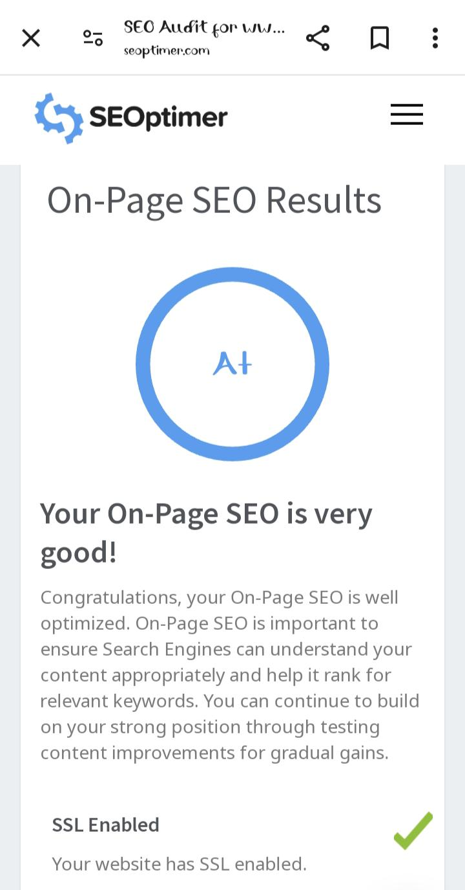
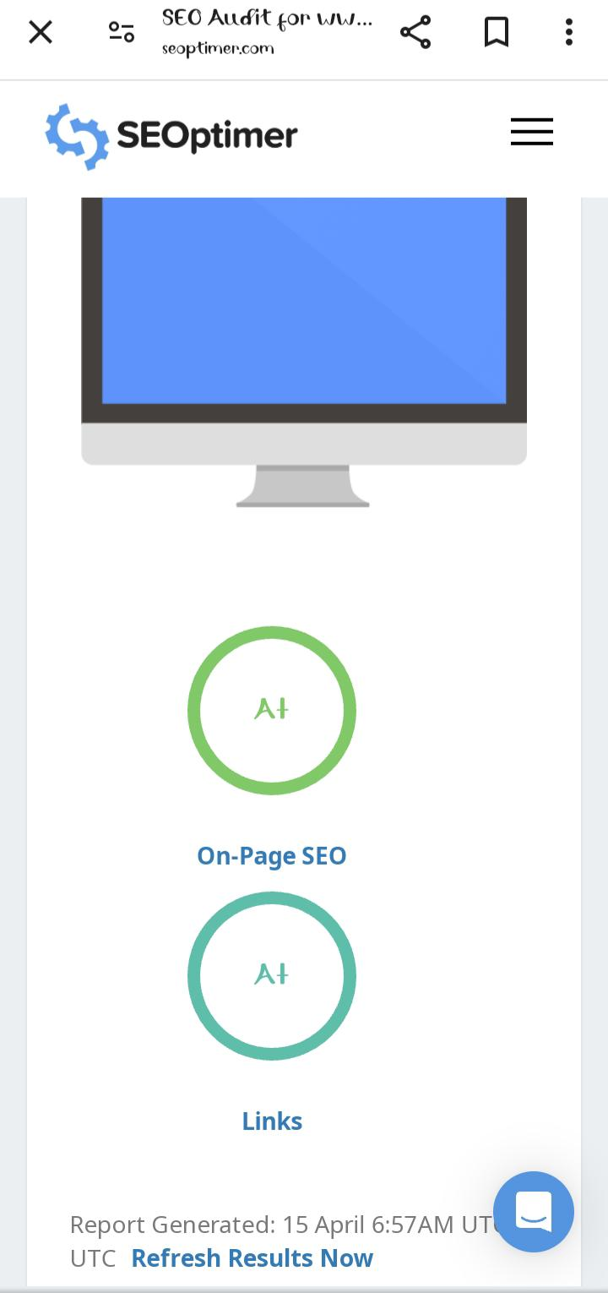
On page Optimization☺:-

Slide 18
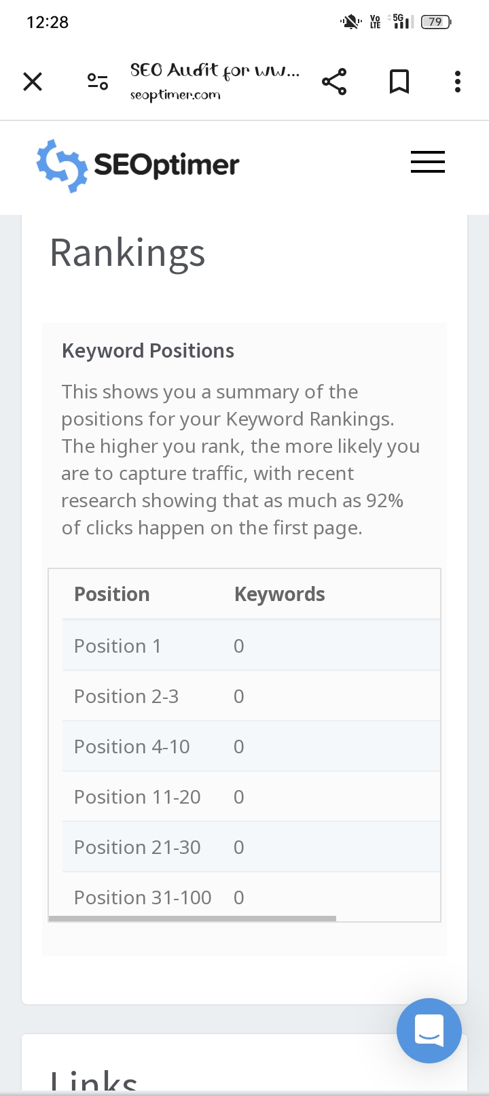
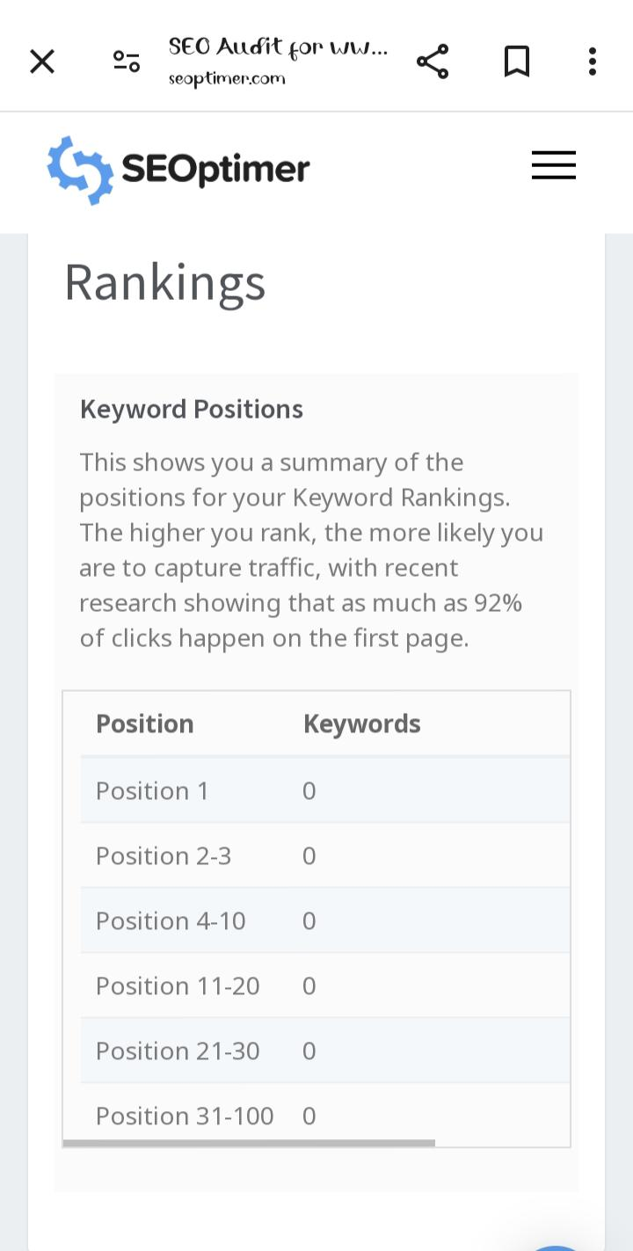
Rankings☺:-

Slide 19
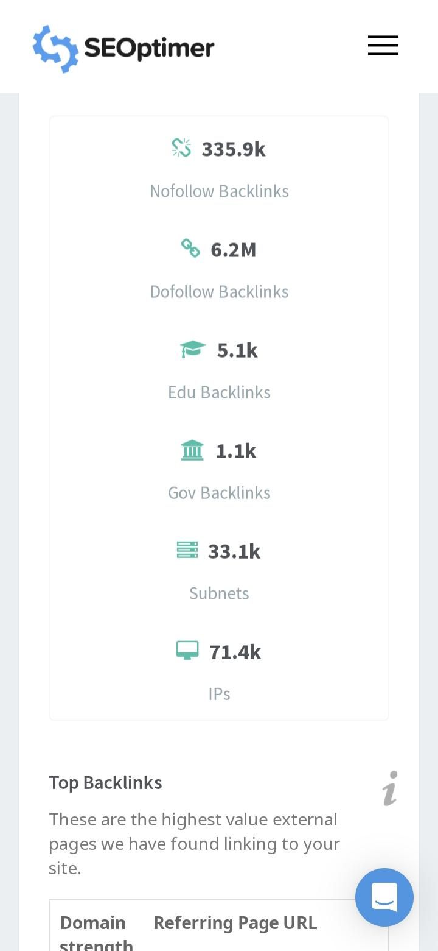
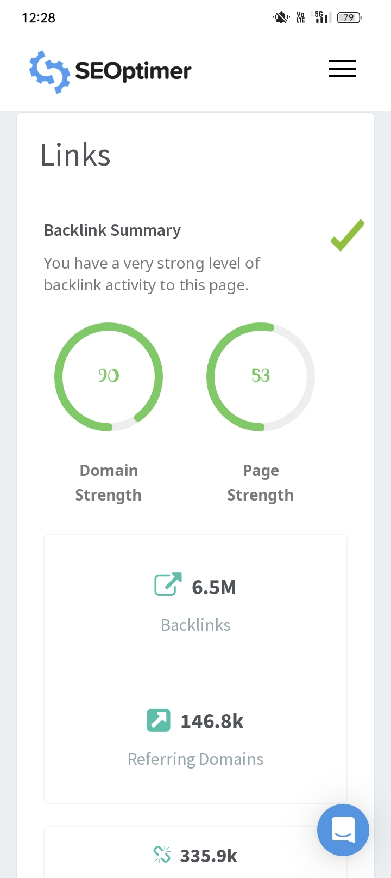
Links☺:-

Slide 20
Part3:-Content Ideas and Marketing Strategies☺:-
Content idea Generating & Strategy:-
For content idea generation and strategy for Kay Beauty, consider the following approach:
Identify Target Audience: Understand the demographics, interests, and pain points of Kay Beauty’s target audience. This will guide content creation to resonate with their needs and preferences. Research Trends: Stay updated on beauty trends, industry news, and popular topics related to cosmetics, skincare, and beauty products. Utilize tools like Google Trends, social media insights, and industry publications for inspiration.
Video Content: Utilize video content formats such as tutorials, demonstrations, product reviews, and brand storytelling to engage audiences visually and increase brand visibility on platforms like YouTube and social media. Collaborations and Influencer Partnerships: Collaborate with beauty influencers, makeup artists, and industry experts to create co-branded content, tutorials, and product collaborations. This expands Kay Beauty’s reach and credibility within the beauty community. SEO Optimization: Ensure that all content is optimized for search engines by incorporating relevant keywords, meta tags, and internal linking strategies.

Slide 21
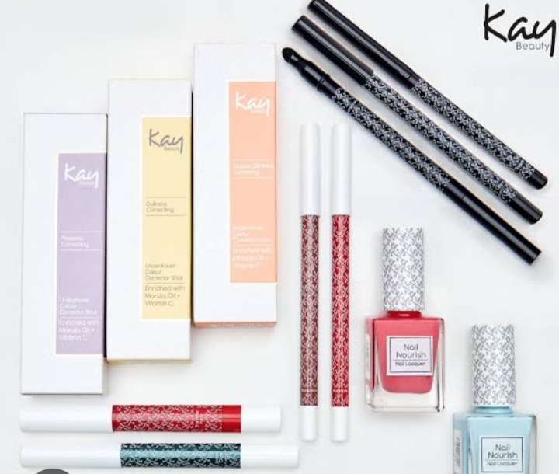
Marketing Strategy of Kay Beauty☺:-
Brand Positioning: Define Kay Beauty’s unique value proposition and brand identity, highlighting what sets it apart from competitors. This could include factors like product quality, ingredient transparency, or a commitment to inclusivity. Target Audience Identification: Conduct market research to identify the target audience’s demographics, preferences, and buying behaviour. This information will inform all marketing efforts to ensure they resonate with the intended audience. Omni-channel Presence: Establish a strong presence across multiple marketing channels, including social media, email marketing, influencer partnerships, content marketing, and search engine optimization (SEO).

Slide 22
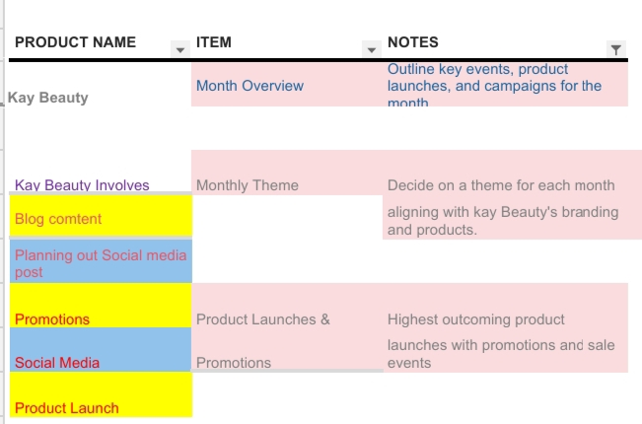
Example☺:-

Slide 23
Part 4:-Content Creation And Curation☺:-
Creating and curating content for Kay Beauty involves showcasing the brand’s products, demonstrating their use through tutorials, sharing beauty tips and tricks, featuring user-generated content, and highlighting any special promotions or events.
This can be done through various channels such as social media, blogs, YouTube, and collaborations with influencers or beauty experts. It’s important to maintain a consistent brand aesthetic and messaging while engaging with the audience authentically.
Content should highlight the unique features and benefits of Kay Beauty’s products while resonating with their target audience’s interests and preferences.
It’s important to stay updated with current beauty trends and maintain a consistent brand image across all platforms.

Slide 24
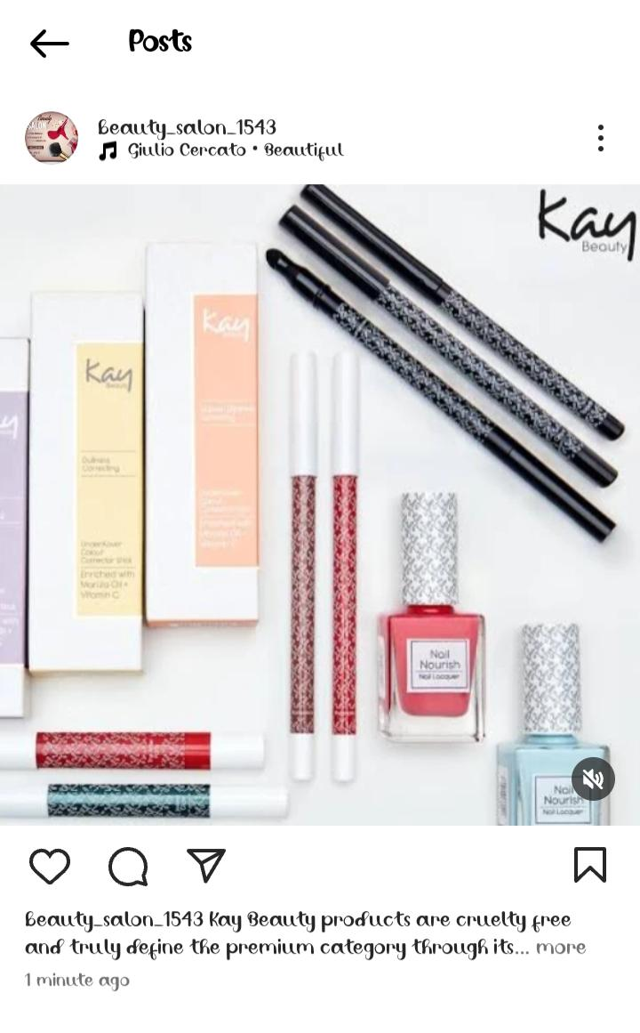
FARMAT 1☺:-
Content Farmat:-Lip crayon
Captain:-
The caption for the Kay Beauty Lip Crayon could be
something like “Glossy Glam with Kay Beauty Lip Crayon! 💄💋” to highlight the product’s shine and glam factor.
CAS:-
The shade “CAS” for the Kay Beauty Lip Crayon collection is a
rich and elegant nude shade called “Caramel Seduction.” It’s
perfect for a subtle yet sophisticated look, complementing a
variety of skin tones.

Slide 25
FARMAT 2:-
Content farmate 2:-Eyeshadow Palette🎨
Caption:-
For the Kay Beauty Eyeshadow Palette, a captivating caption could be: “Transform your gaze with Kay Beauty Eyeshadow Palette – where every shade tells a story of elegance and allure.🎨👀”
CAS:-
The “CAS” of the Kay Beauty Eyeshadow Palette collection is a versatile and timeless palette called “Classic Allure.” It features a range of neutral and earthy tones perfect for creating both everyday looks and glamorous evening styles.

Slide 26
FARMAT 3☺:-
Content farmate 3:- Foundation
Caption:-
For the Kay Beauty Foundation, a compelling caption might be: “Discover flawless radiance with Kay Beauty Foundation – your secret to effortless beauty that lasts all day.”
CAS:-
The “CAS” (Classic Allure Shade) of the Kay Beauty Foundation is a natural and adaptable shade called “Sunlit Beige.” It offers a seamless blend with various skin tones, providing a radiant finish for a luminous complexion.

Slide 27
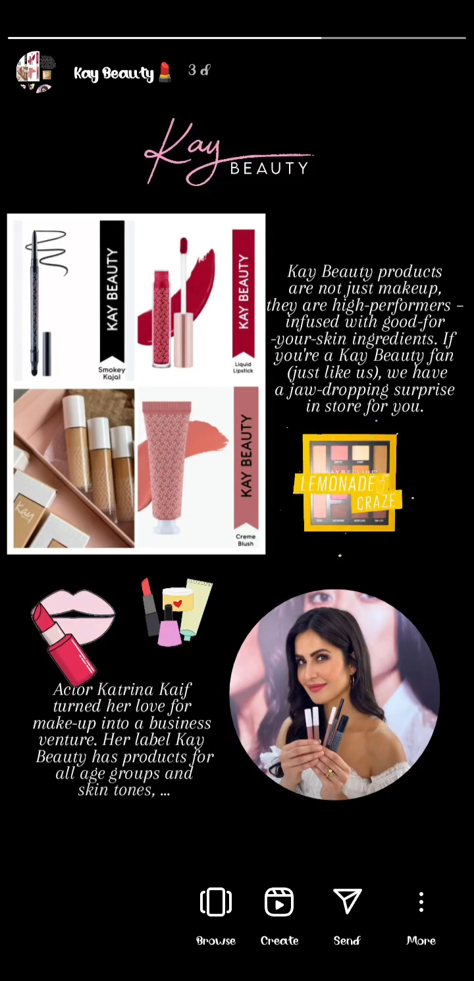
Instagram Story☺:-

Slide 28
Instagram Link☺:-
Instagram Link:-
https://www.instagram.com/s/aGlnaGxpZ2h0OjE4NDMwODM1MjMwMDU5OTYz?story_media_id=3348046272278629397_65323546135&igsh=MXRwODNkZHh0bXEzaA==

Slide 29
Design’s/ Video Editing☺:-
I can use apps like Canva,VN app for designing and editing videos.
Canva has cool templates and features to make our designs and videos look awesome Give it a try for your next creative project.
And it is also give good videos editing and also VN app is use for good editing photos with using videos.

Slide 30


